Slide 1


Renewmarket - A Second Hand-Goods MarketPlace Platform
ITA0203-WEB TECHNOLOGY FOR FREE LANCER
Guided By:
Dr Moorthy Dr Arul Raj
By:
Prartana T(192421099) Kaviya V(192421022)

Slide 2

AIM & OBJECTIVE
To develop an online marketplace where sellers can upload and manage their products easily.
To allow buyers to browse, view details, and purchase products in a simple and user-friendly platform.
To ensure product removal after purchase and update the seller about the sale and earnings received.
To enable admin monitoring of all transactions, including commission tracking and product management.
To provide a reliable system that manages products, users, and sales smoothly without errors.

Slide 3

ABSTRACT
This project is an online marketplace that connects sellers and buyers through a web platform.
Sellers can upload products with images and details, while buyers can view and purchase products easily.
Once a product is purchased, it is removed from the platform, and the seller is notified with earnings information.
The system ensures transparency for the admin, secure transactions, and smooth communication between all users.

Slide 4
LITERATURE REVIEW
AUTHOR/YEAR | TITLE | SYSTEM/TECHNOLOGY STUDIED | FINDINDS
Univio (2023) | E-Commerce Trends in 2023 | E-commerce and marketplace design | Emphasized intuitive user interfaces and smooth browsing, inspiring clear dashboards in RenewMarket.
WebInterpret (2025) | Data Management & Storage | Data structuring and file management systems | Suggested transparent management and real-time updates, shaping the admin monitoring system.
Komprise (2024) | Online Marketplace Strategies | Online trading and performance optimization | Guided secure data handling and efficient JSON storage for reliable backend organization.
Sharma & Gupta (2022) | Secure Web Transactions using Node.js | Node.js and Express-based web applications | Introduced secure login methods in Node.js, influencing RenewMarket’s authentication module.
Kumar et al. (2023) | Role-Based Access in Web Systems | Role and permission management | Highlighted role-based access control, supporting RenewMarket’s multi-user management design.

Slide 5
EXISTING SYSTEM
Most current marketplaces have limited seller control, where sellers cannot properly track product sales or earnings.
Buyers face communication gaps due to no direct updates about payment confirmation or product availability.
Admins often need to manage everything manually, which increases time and error risk in approval or removal of sold products.
Sold products remain visible in listings, causing confusion and poor user experience for buyers and sellers.

Slide 6
PROPOSED SYSTEM
A web platform where sellers can upload products and buyers can purchase easily.
Purchased products are removed automatically, and sellers are notified of earnings.
Admin monitors all transactions and commissions efficiently.
Clear, simple dashboards for sellers, buyers, and admin.

Slide 7
SOFTWARE REQUIREMENTS
Operating System: Windows / macOS / Linux
Web Server: Node.js with Express
Database & Storage: JSON files for products, orders, and wallets
Frontend: HTML, CSS, JavaScript for user-friendly dashboards

Slide 8
SYSTEM ARCHITECTURE
BUYER
PANEL
SELLER
PANEL
ADMIN
PANEL
Node.js + Express
JSON

Slide 9
DESIGN & MODULE PLANNING
Module 1: Seller & Product Management
Module 2: Buyer Purchase & Admin Control
Ensure real-time notifications for admins and sellers work properly.
Validate overall data consistency between buyer, seller, and admin panels.

Slide 10
MODULE 1
SELLER & PRODUCT MAMAGEMENT

Slide 11
MODULE 1 : DEVELOPMENT
Sellers can log in and upload products with multiple images using a simple form.
Used Node.js and Multer for secure image upload and storage.
Product details are saved in JSON files with seller name and timestamp.
Sellers can edit or delete their listings anytime through the dashboard.
Real-time updates ensure new or modified products appear instantly for buyers and admin.

Slide 12
MODULE 1: METHODOLOGY
Seller logs in and adds product details via a form.
Multiple images can be uploaded for each product.
Product data is stored in JSON files.
Real-time updates reflect product availability immediately.

Slide 13
MODULE 1: SYSTEM DESIGN
Seller Dashboard displays all products in a card layout.
Options to edit or delete products.
Upload form for new products with image preview.

Slide 14
MODULE 1: TESTING & REVIEW
Test product upload and image storage.
Verify that product details save correctly in JSON.
Check that updates and deletions reflect on all panels.
Ensure real-time notifications for admins and sellers work properly.

Slide 15
MODULE 2
Buyer Purchase & Admin Control

Slide 16
MODULE 2: DEVELOPMENT
Buyers can browse and purchase available products through an interactive interface.
Purchased items are automatically removed from listings after confirmation.
The Admin Panel tracks sales, updates commissions, and monitors transactions.
All changes are synced in real time between buyer, seller, and admin dashboards.
System ensures secure transactions, accurate data handling, and transparent management.

Slide 17
MODULE 2: METHODOLOGY
Buyer browses products and selects items to purchase.
Purchase triggers automatic removal of the product from all panels.
Admin receives updated sales information and calculates commission.

Slide 18
MODULE 2: SYSTEM DESIGN
Buyer Dashboard shows products in a grid layout.
Purchase API handles transactions and product removal.
Admin Dashboard tracks orders, wallet balances, and commissions.

Slide 19
MODULE 2: TESTING & REVIEW
Verify purchase flow for accuracy.
Ensure purchased products are removed immediately.
Check admin commission calculations for correctness.
Validate overall data consistency between buyer, seller, and admin panels.

Slide 20
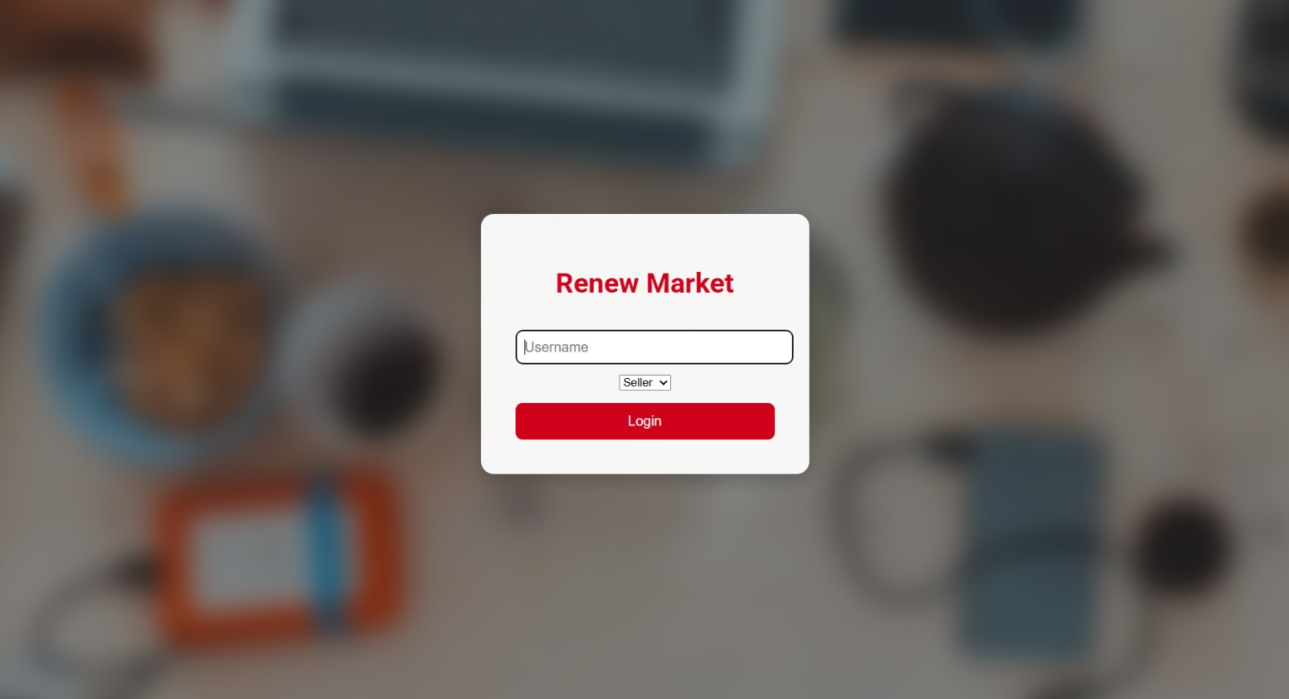
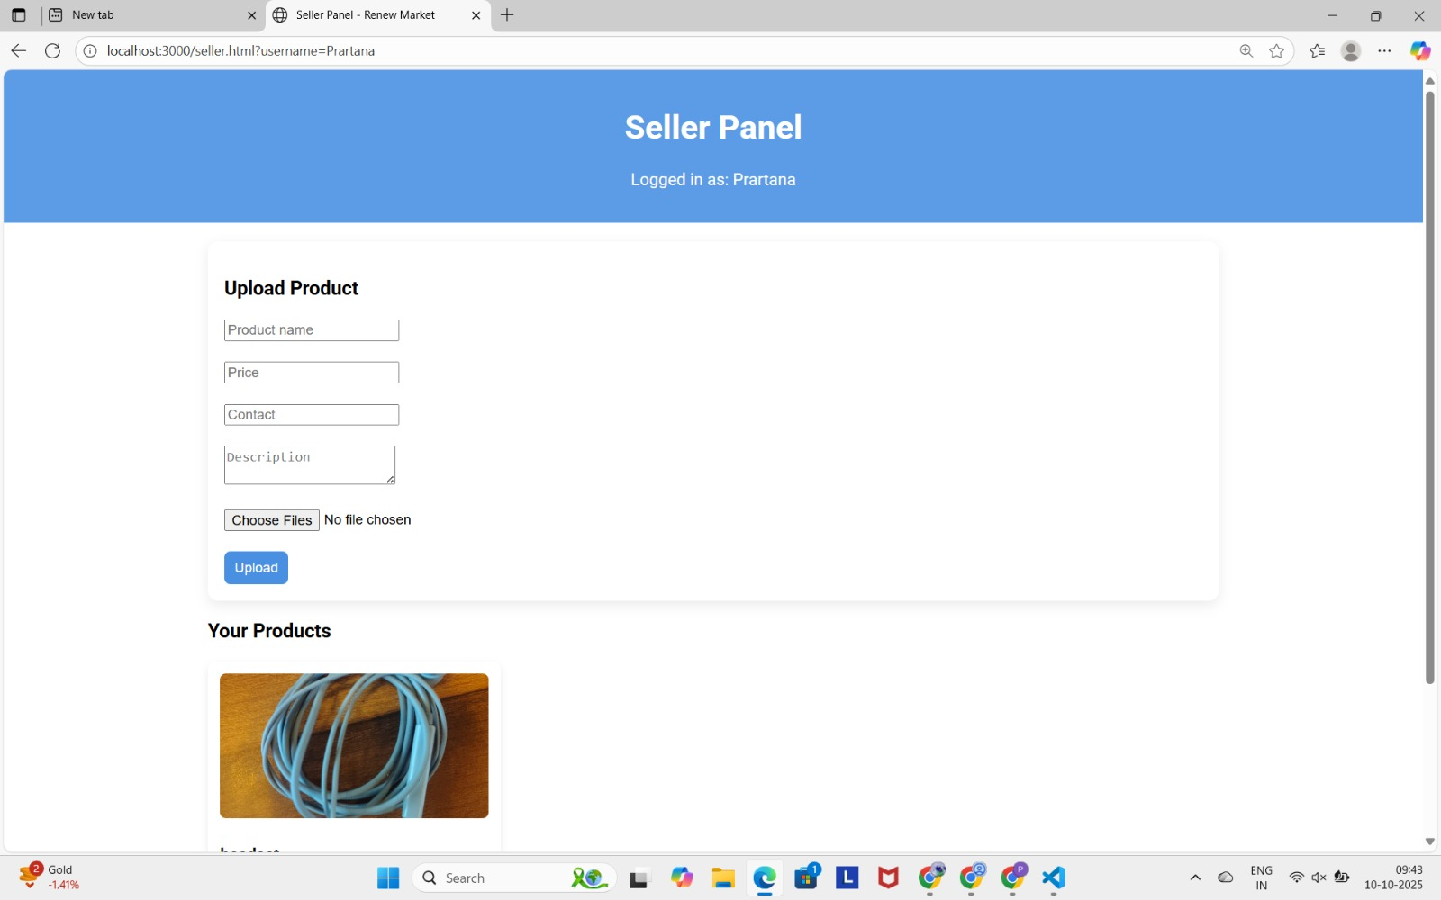
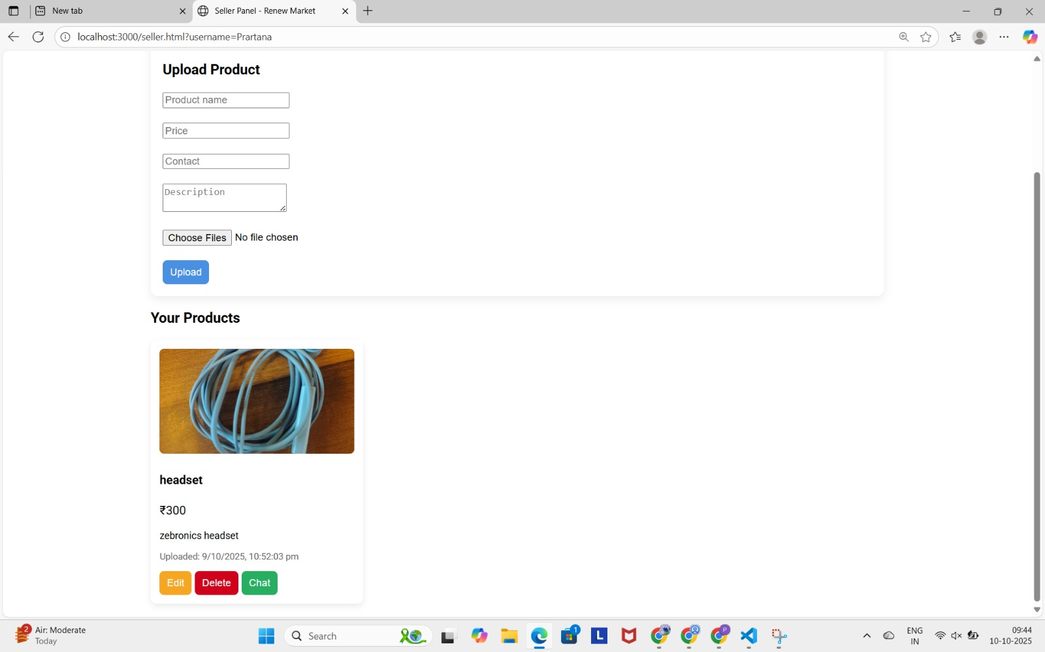
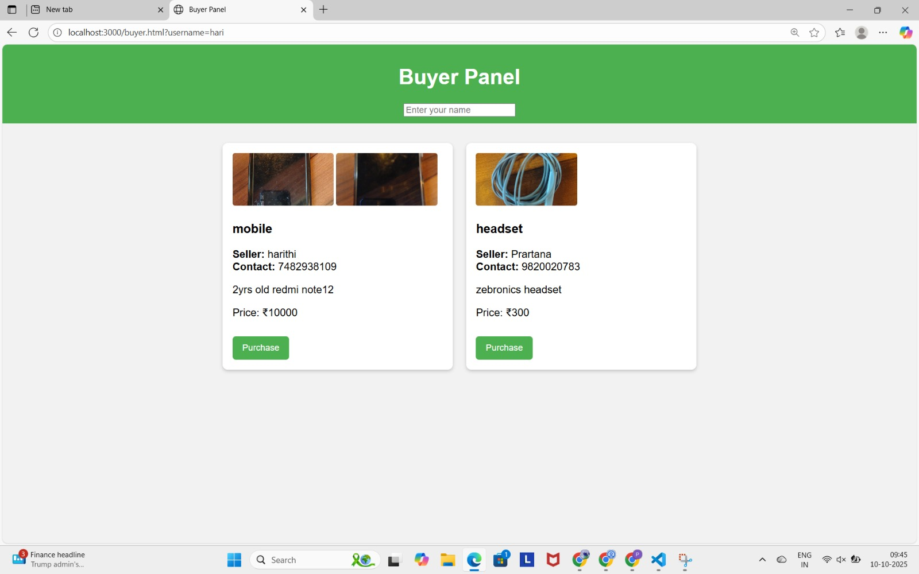
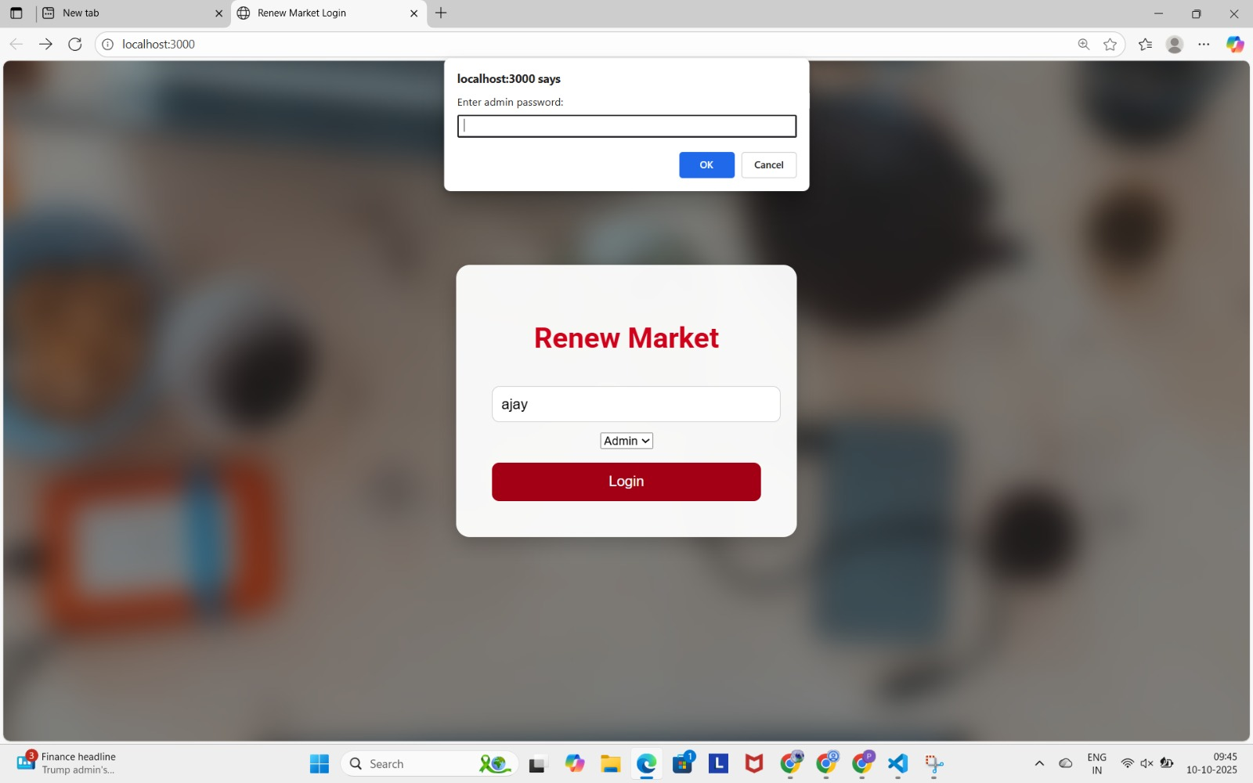
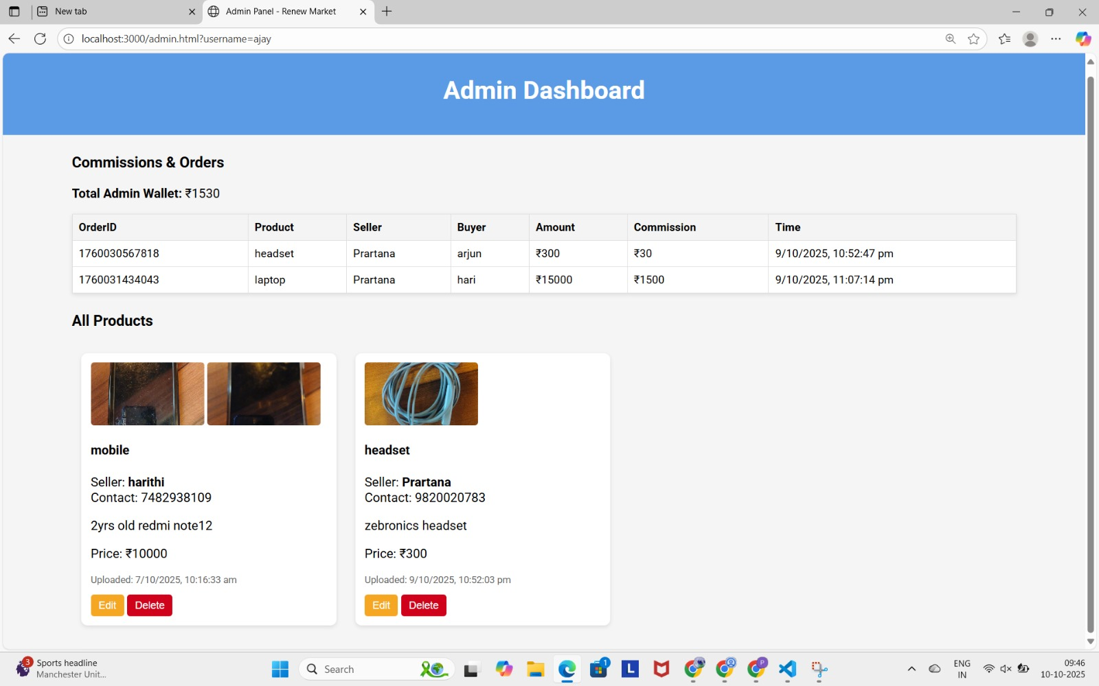
IMPLEMENTATION & RESULT

Slide 21
SYSTEM DEBBUGING & OPTIMIZATION
Fixed real-time update issues so all panels reflect changes instantly.
Ensured uploaded images are correctly stored and displayed.
Deleted product images automatically after purchase to save storage.
Optimized page load speed and UI responsiveness.
Prevented duplicate purchases and ensured smooth transaction flow.

Slide 22

FULL SYSTEM TESTING
Unit Testing: Verified each feature individually (product upload, edit, delete).
Integration Testing: Checked real-time updates between buyer, seller, and admin panels.
Functional Testing: Ensured all modules perform their intended tasks correctly.
User Acceptance Testing (UAT): Confirmed the system works smoothly for all users.
Error Handling: Validated proper alerts for invalid inputs or failed transactions.

Slide 23
CONCLUSION
The online marketplace successfully connects sellers, buyers, and admin in a single platform.
Products are managed efficiently, with automatic removal after purchase.
Admin can monitor transactions and commissions easily, ensuring transparency.
The system provides a smooth, user-friendly, and error-free experience for all users.
The project is scalable for future enhancements like payment integration or additional modules.

Slide 24
REFERENCES
Node.js Official Documentation
Express.js Guides –
MDN Web Docs – HTML, CSS, JavaScript
Multer Image Upload Documentation
JSON Data Storage Models – Various online tutorials

Slide 25
THANK YOU!

